Slide 1
Data Structures and Algorithms -3 (25CS2103E)
Text Search and Intelligent Query Engine
Team Members
V.VedaPriya 2520030376
M.Thanishka 2520030583
P.Hamsika 2520030586
Under the Esteemed Guidance of
Dr.Yamini Devi
department of CSE

Slide 2
Contents
Abstract
Introduction
Literature Survey
Problem Statement and Objectives
System Flow Chart
Hardware and Software Requirements
Implementation Overview
Results and Discussion
Conclusion
Future Scope

Slide 3
Abstract
  The Text Search and Intelligent Query Engine is a Java-based console application for searching and analyzing text files. It supports a predefined dataset and a user-provided .txt file. The implemented algorithms are Knuth-Morris-Pratt (KMP) for single-pattern searching, Edit Distance for closest-word matching, Aho-Corasick for multiple-keyword searching, Suffix Array for suffix indexing, and LCP Array for common-prefix analysis. The selected text is shared across operations. KMP, Edit Distance, and Aho-Corasick process the complete text, while Suffix Array and LCP Array analyze up to the first 6,000 characters. The current version does not implement Rabin-Karp, the Z Algorithm, execution-time benchmarking, or a web interface.

Slide 4
Introduction
Text searching is used in document processing, search tools, and information retrieval. As text collections grow, efficient algorithms help locate patterns and analyze content. Our project brings five string-processing techniques into one Java console application. The user selects a dataset, chooses an operation from the menu, and views the result. The Main class controls the program flow, DataSet reads and stores the text, and each algorithm class performs its specific task. The application can read the included dataset or a custom plain-text file from the local computer.

Slide 5
Literature Survey
String-processing systems use different algorithms depending on the search task. Knuth-Morris-Pratt (KMP) uses an LPS array to avoid repeating comparisons during single-pattern searching. Edit Distance uses dynamic programming to measure the minimum insertions, deletions, and substitutions between words. Aho-Corasick combines multiple patterns in a trie and uses failure links to search for them in one text traversal. Suffix Arrays organize suffixes in sorted order, while LCP Arrays store common-prefix lengths between adjacent suffixes. These five techniques are implemented in this project.

Slide 6
Problem Statement
Searching and analyzing text involves several different tasks: finding one pattern, identifying a likely spelling match, searching multiple keywords, and examining repeated prefixes. Using a separate basic approach for each task can be inefficient. The project addresses this by providing a menu-driven Java application that loads a text dataset once and applies an appropriate algorithm according to the user's choice.

Slide 7
Objectives
• Load the predefined dataset or a user-selected .txt file.
• Search for a single pattern using KMP.
• Find a closest word match using Edit Distance.
• Search multiple keywords using Aho-Corasick.
• Build a Suffix Array for text indexing.
• Calculate an LCP Array for adjacent sorted suffixes.
• Demonstrate the use of Java file handling, arrays, collections, queues, and strings.

Slide 8
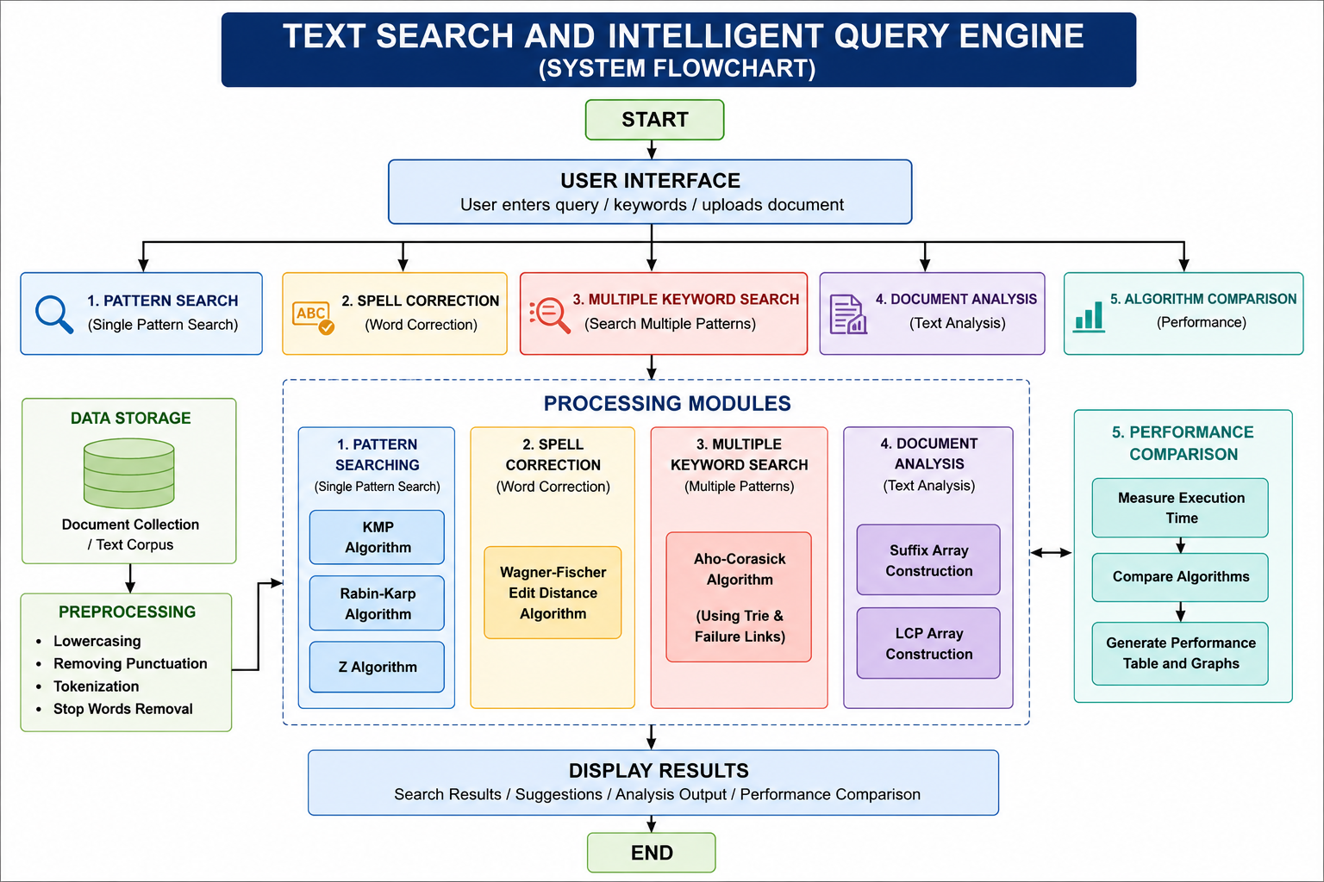
Flow Chart
Start / Run Main.java
Select dataset source
Load .txt using DataSet.java
Display operation menu
KMP
Single pattern
Edit Distance
Closest word
Aho-Corasick
Multiple keywords
Suffix Array / LCP
First 6,000 chars
Display results / choose another operation / exit

Slide 9
Results
The application provides the following implemented operations:
1. KMP: searches the complete selected text for one pattern and reports the occurrence count and first matching positions.
2. Edit Distance: compares the input against unique words from the dataset and reports the closest match and distance.
3. Aho-Corasick: searches multiple keywords in the complete text and reports each keyword's count.
4. Suffix Array: sorts suffix indexes for up to the first 6,000 characters and displays the first 20 indexes.
5. LCP Array: calculates common-prefix lengths for adjacent sorted suffixes and displays the first 20 values.
The predefined dataset contains approximately 4.46 million characters and 25,000 newline-separated records. Actual output screenshots should be added from a program run. Execution-time comparison is not implemented in the current version.

Slide 10
Hardware and Software requirements
Hardware Requirements
• Computer or laptop
• 4 GB RAM or more recommended
• Intel Core i3 or equivalent processor
• Sufficient storage for the dataset and JDK
Software Requirements
• Java Development Kit (JDK)
• Java compiler (javac) and Java Virtual Machine (JVM)
• Windows, Linux, or macOS
• VS Code, IntelliJ IDEA, Eclipse, or another text editor/IDE
• Command Prompt or terminal
• Plain-text dataset (.txt)
The submitted project is a Java console application. HTML, CSS, JavaScript, a web browser, and a database are not required for the current implementation.

Slide 11
Conclusion
The project demonstrates the practical use of five string-processing algorithms in a single Java application. It supports predefined and user-provided text files and provides single-pattern searching, closest-word matching, multiple-keyword searching, suffix indexing, and common-prefix analysis. The project also demonstrates how Java file handling and collections can be combined with algorithmic techniques. The current implementation provides a foundation for future improvements such as performance measurement, advanced indexing, and a graphical interface.

Slide 12
Future Scope
Future improvements may include:
• Measuring and comparing algorithm execution times.
• Adding Rabin-Karp and the Z Algorithm as additional pattern-matching options.
• Using a more efficient Suffix Array construction algorithm for larger text.
• Adding a graphical or web-based user interface.
• Supporting UTF-8 text and additional document formats.
• Adding highlighted matches, search history, and relevance ranking.
• Extending the system to search across multiple documents.

Slide 13
Thank you

